Slide 1
Affirmed vEPC with Contrail Netronome SmartNIC test report (DT Pannet infra.)
DT Pan-net
Wojciech Śronek, SRE
November 2018

Slide 2
DT Pannet vEPC environment specification
Openstack Ocata
Contrail 4.1.1 (SmartNIC Computes uses 4.1.2-15 due to fixes)

Slide 3
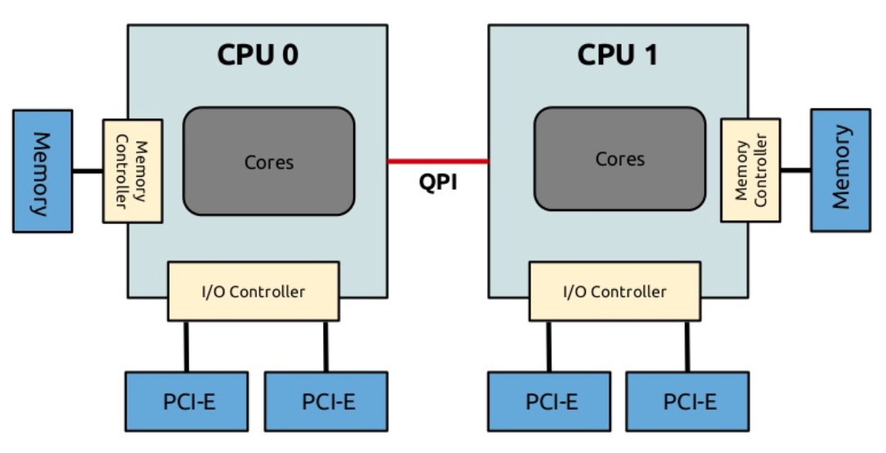
DT Pannet vEPC environment specification
Intel Xeon E5-2660 v4 2GHz (dual socket)
14 cores per CPU
HT
256 GB RAM (2 x 128GB per NUMA)
2 x 40GE Netronome Agilo CX NIC (80GE LACP)
SmartNIC works with virtio-forwarder Pannet requirement is to provide very generic cloud for all workloads using virtio driver
MCC SSM VM
(vEPC dataplane VM)
14 cores
(28 lcores)
Netronome SmartNIC LACP (2x40Gbps)

Slide 4
Mobile User traffic pattern definition
UPLINK (50% of traffic)
20% of 100-byte packets
20% of 140-byte packets
20% of 180-byte packets
20% of 220-byte packets
20% of 260-byte packets
DOWNLINK (50% of traffic)
20% of 850-byte packets
20% of 950-byte packets
20% of 1050-byte packets
20% of 1150-byte packets
20% of 1250-byte packets
The average packet size is 615 bytes

Slide 5
NUMA usage
SmartNIC is connected to NUMA 0
Virtio-forwarder uses 4 cores (2 per NUMA)
S1U interface is pinned to cores (1 NUMA 0 and 14 NUMA 1)
SGi interface is pinned to cores (2 NUMA 0 and 15 NUMA 1)
MCC SSM VM (vEPC dataplane VM) has 22 lcores assigned (NUMA 0)

Slide 6
MCC SSM configuration
Affirmed vEPC is configured in TAM mode (no EW traffic)
DPI is turned off
MCC SSM VM (vEPC dataplane VM) has 22 lcores assigned (NUMA 0)
S1U and SGi interfaces works in packet-based mode

Slide 7
Virtio-forwarder location
Compute
VNF SSM
rx io | ppc | tx io
virtio netdev
interface rxq
interface txq
Userspace
virtio-forwarder
tx
rx
SmartNIC
vf
offloaded vRouter dataplane

Slide 8
Test result with a single VM
3 Mpps in each direction (incoming/outgoing)
1.5 Mpps S1U RX, 1.5 Mpss SGi TX UPLINK
1.5 Mpps SGi RX, 1.5 Mpps S1U TX DOWNLINK
20 Gbps in each direction (incoming/outgoing)
2.5 Gbps S1U RX, 2.5 Gbps SGi TX UPLINK
13 Gbps SGi RX, 13 Gbps S1U TX DOWNLINK
Compute
UE
(User Equipment)
1.5 Mpps
MCC SSM VM
1.5 Mpps
PDN
(Internet)
S1U interface
SGi
interface
1.5 Mpps
1.5 Mpps

Slide 9
Problem we see when we reach 3 Mpps
rx_vm_queue_full dropping increasing
Compute
VNF SSM
rx io | ppc | tx io
virtio netdev
SSM is not able to accept so many packets.
Netronome and Affirmed are in touch to improve. One of the possible solutions is to increase number of SSM IO cores from 2 to 4.
interface rxq
interface txq
Userspace
virtio-forwarder
tx
rx
SmartNIC
vf
offloaded vRouter dataplane
FROM_WIRE_TX_HOST_ERR increasing - which is a result of rx_vm_queue_full

Slide 10
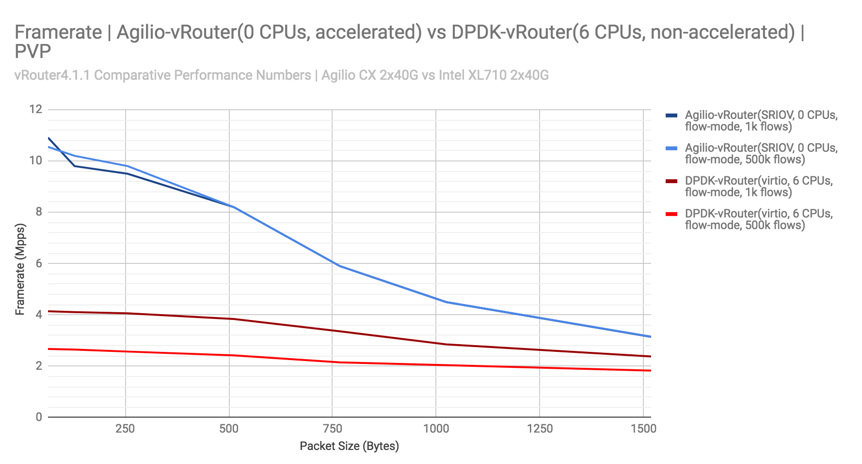
Netronome results with DPDK PROX App
Netronome with 615-byte packets get 7 Mpps (in each direction)

Slide 11
Current assumptions
As Affirmed never confirmed how much pps they are able to process over a single SSM (22 lcores) in the setup with Broadwell CPUs we took their results from pure SRIOV tests (36 lcores, Skylake) and calculated pps per core.
Affirmed pure SRIOV test (Skylake CPU) 36 lcores NUMA 0 (5 Mpps, 27 Gbps) - which gives 0.138 Mpps per core
Affirmed with SmartNIC (virtio-forwarder) test (Broadwell CPU) 22 lcores NUMA 0 (3 Mpps, 15.5Gbps) - which gives 0.136 Mpps per core Based on other tests with other traffic we concluded that SSM is able to process maximum traffic between 3 and 3.5Mpps in current setup (CPU 100%)

Slide 12
Next DT Pannet steps (January/February 2018)
Build new DC networking fabric based on 100G interfaces (current fabric limits us to run performance test with 4 SSM VMs (each SSM on different Compute))
Change all Computes to Skylake (22 cores per NUMA)
Deploy MCC SSM VMs with 36 lcores
In that setup if we see 5 Mpps in each direction per SSM (and we are 100% sure we will) we would be able to say that SmartNIC with virtio-forwarder gives the same mobile performance results as pure SRIOV.

Slide 13
Current open issues
Wrong NH calculated by Agent
https://bugs.launchpad.net/juniperopenstack/+bug/1798086 Saurabh and vRouter Agent team provided fix. So far we are not seeing occurrence of that issue.
Flow with Action Drop (Unknown) https://bugs.launchpad.net/juniperopenstack/+bug/1800128 Currently we use packet mode so it is not impacting tests. We are waiting for confirmation from Engineering which release will have that issue solved.
Bond interface disconnects from time to time
The fix is being prepared by Netronome and should be ready very soon. It looks like LACP doesn’t work well with MC-LAG.

